Slide 1
Capstone Project
www.collaberadigital.com

Slide 2
Personal BACKGROUND
(Name, Past Experience, Qualification, Career Summary)
Name : Presmelito R. Villanueva Jr.
Past Experience : PHP Developer – 4 years
Qualification : Java Servlets, Spring Framework
Career Summary : I am a software engineer specialized in PHP Laravel and VueJS Framework.

Slide 3
What I have learned.
Key Takeaways/Learnings from the Program (HTD)
How to do modification on the existing business flow by creating and extending existing controllers that is being executed by default.
How to create Custom API endpoints to extend the framework
How to customize the out of the box storefront UI
Data utilities & Administrative Consoles:
Dataload
Acpload
Accelerator Console
Management Center
How to configure search profiles in solr search.

Slide 4
Problem Statement of the Capstone Project
Part 1:
Step1
Add data into catentry table field 3,4 via data load.
Field3 = product ranking
field4 = rating Company
Part 1:
Step2
Add product ranking and rating Company to solr index and display information on PDP page

Slide 5
Problem Statement of the Capstone Project
Part 1:
Step3
Add one descriptive attribute for product via dataload
Step4
On add to cart page:
Allow user to add gift wrap service and add a message in
Item when gift wrap service is selected
Display item gift message on shopping cart & order confirmation

Slide 6
Problem Statement of the Capstone Project
Part 2:
Step1
Create a new custom table - UserId, Favorite food, Favorite colour.
Step2
Create a JPA to save, update and read from this table.
Step 3
Create a new JSP page to take this data from user.
Add a new link in Settings below QUick Checkout Profile.
Step 4
Create a new controller command to save this information 5.
Save this form data in WCS DB using JPA and Controller command.

Slide 7
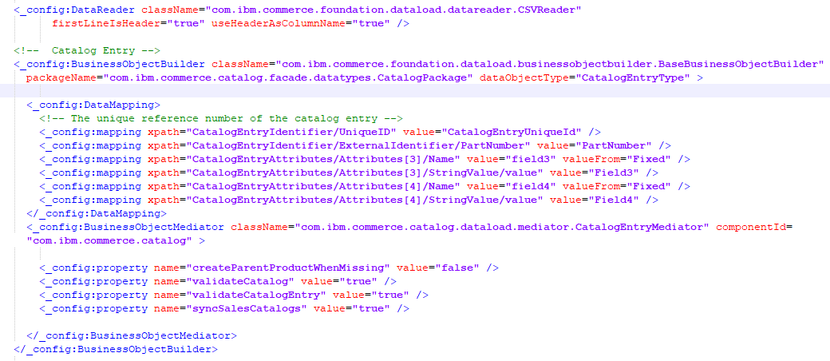
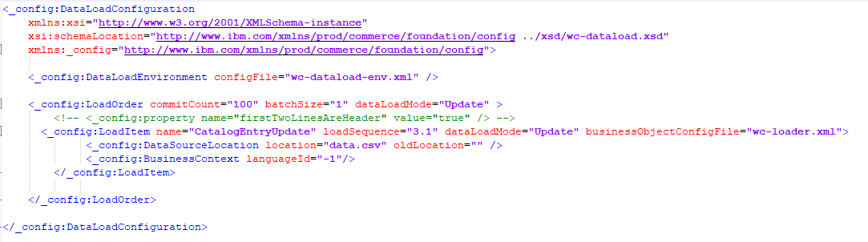
PART 1 STEP 1
wc-loader.xml
wc-dataload.xml

Slide 8
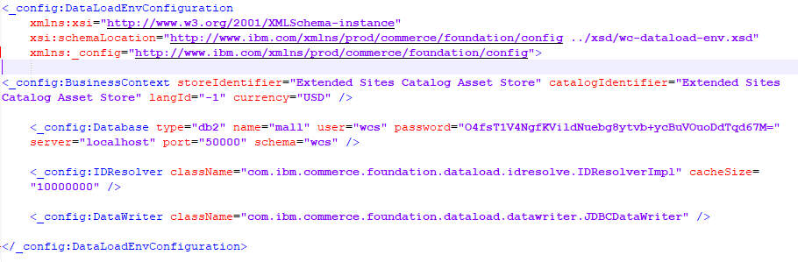
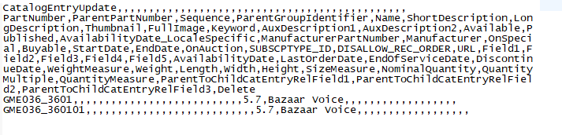
PART 1 STEP 1
wc-dataload-env.xml
data.csv

Slide 9
PART 1 STEP 1
wc-dataload-env.xml
data.csv

Slide 10
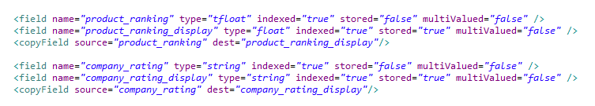
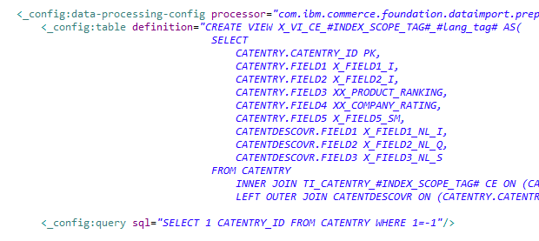
PART 1 STEP 2
/search-config-ext/src/index/managed-solr/config/v3/CatalogEntry/x-schema.xml
/WC/xml/search/dataImport/v3/db2/CatalogEntry/wc-dataimport-preprocess-x-finalbuild.xml

Slide 11
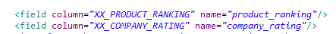
PART 1 STEP 2
/search-config-ext/src/index/managed-solr/config/v3/CatalogEntry/x-data-config.xml
Build Index
curl --user spiuser:passw0rd --insecure -X POST https://localhost:443/wcs/resources/admin/index/dataImport/build?masterCatalogId=10001
Check Build if Successful
curl --user spiuser:passw0rd --insecure -X GET https://localhost:443/wcs/resources/admin/index/dataImport/status?jobStatusId=1501
Check in solr if new fields are there.
http://localhost:3737/solr/MC_10001_CatalogEntry_en_US/select?q=catentry_id:12769

Slide 12
PART 1 STEP 2
/search-config-ext/src/index/managed-solr/config/v3/CatalogEntry/x-data-config.xml
Build Index
curl --user spiuser:passw0rd --insecure -X POST https://localhost:443/wcs/resources/admin/index/dataImport/build?masterCatalogId=10001
Check Build if Successful
curl --user spiuser:passw0rd --insecure -X GET https://localhost:443/wcs/resources/admin/index/dataImport/status?jobStatusId=1501
Check in solr if new fields are there.
http://localhost:3737/solr/MC_10001_CatalogEntry_en_US/select?q=catentry_id:12769

Slide 13
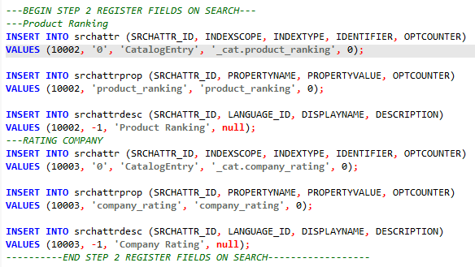
PART 1 STEP 2
Register new fields in search table

Slide 14
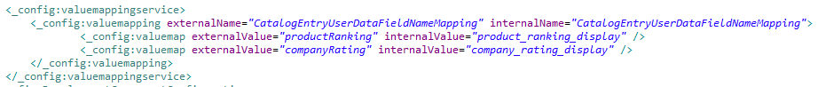
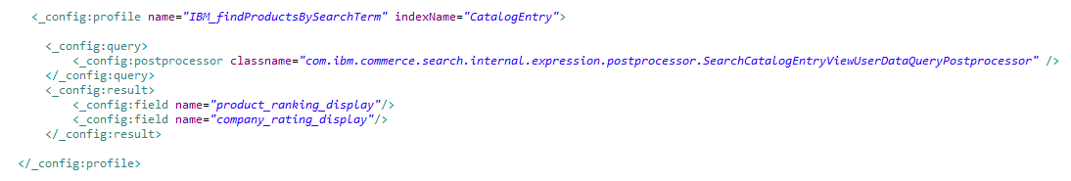
PART 1 STEP 2
Add the following mapping into your file before the end of the </_config:valuemappingservice> element.
/search-config-ext/src/runtime/config/com.ibm.commerce.search/wc-search.xml
Check if fields are appearing on search
https://localhost:3737/search/resources/store/1/productview/byId/12769

Slide 15
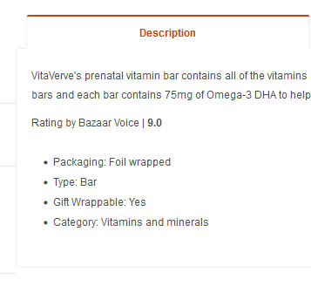
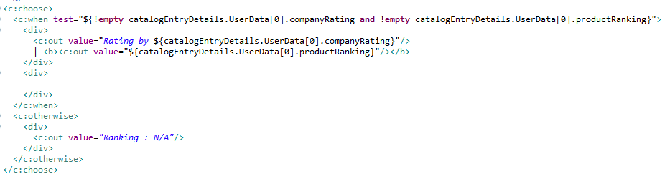
PART 1 STEP 2
DISPLAY THE RATING
Display properties on Descriptive Attributes Widget.

Slide 16
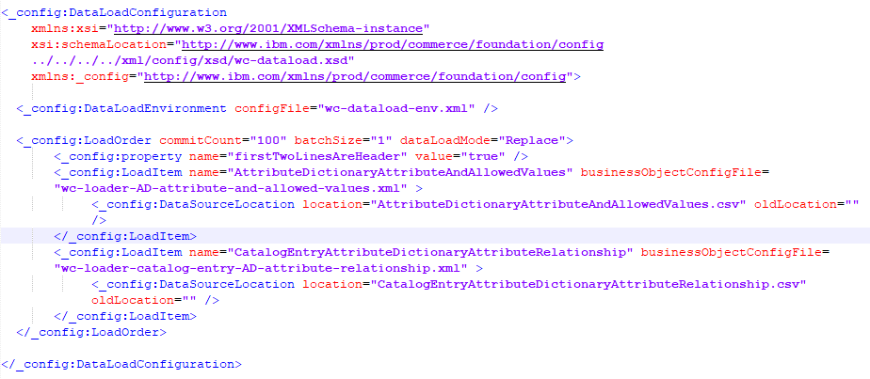
PART 1 STEP 3
wc-dataload.xml

Slide 17
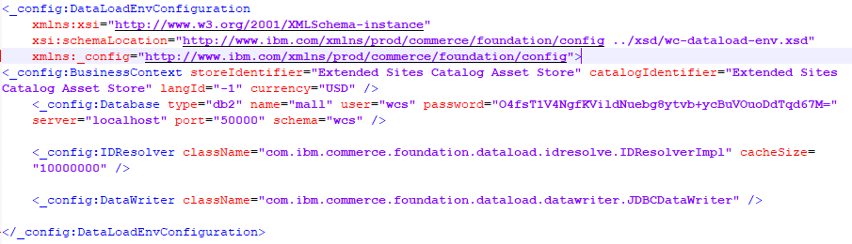
PART 1 STEP 3
wc-dataload-env.xml

Slide 18
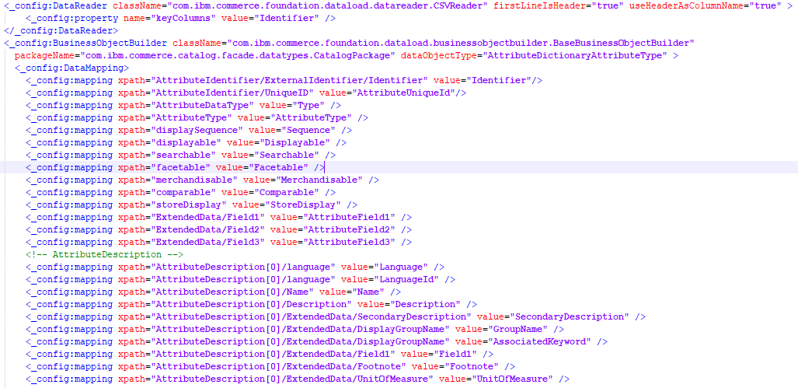
PART 1 STEP 3
wc-loader-AD-attribute-and-allowed-values.xml (part 1)

Slide 19
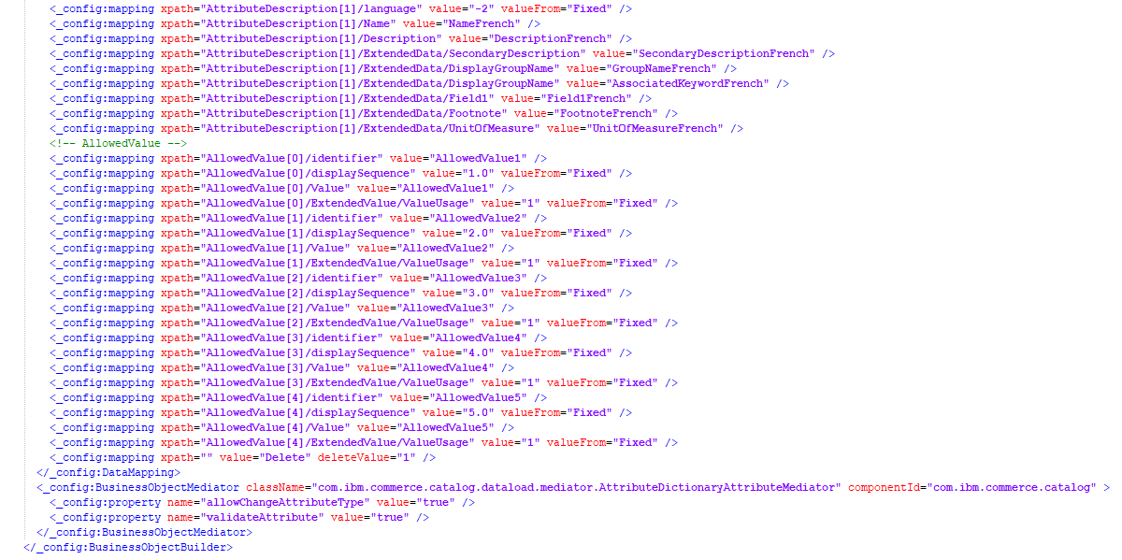
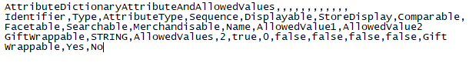
PART 1 STEP 3
AttributeDictionaryAttributeAndAllowedValues.csv
wc-loader-AD-attribute-and-allowed-values.xml (part 2)

Slide 20
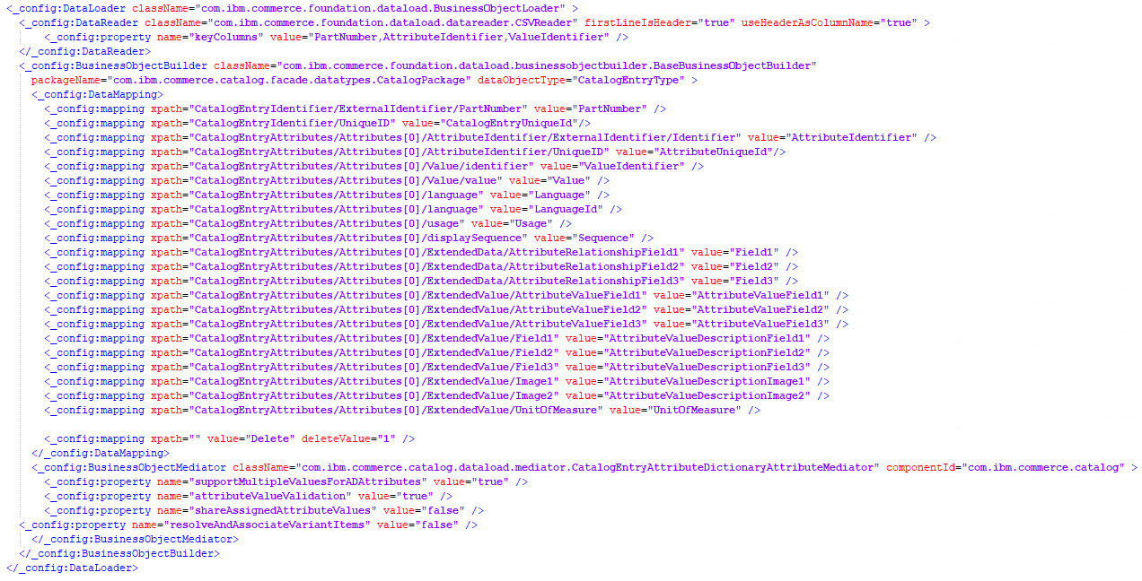
PART 1 STEP 3
wc-loader-catalog-entry-AD-attribute-relationship.xml

Slide 21
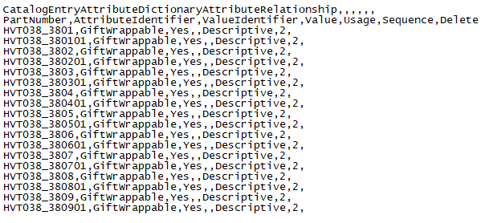
PART 1 STEP 3
CatalogEntryAttributeDictionaryAttributeRelationship.csv
Execute Data Load
:> dataload wc-dataload.xml
Build Index
curl --user spiuser:passw0rd --insecure -X POST https://localhost:443/wcs/resources/admin/index/dataImport/build?masterCatalogId=10001
Check Build if Successful
curl --user spiuser:passw0rd --insecure -X GET https://localhost:443/wcs/resources/admin/index/dataImport/status?jobStatusId=1501
Check if gift wrappable attribute is available in product object
http://localhost:3737/search/resources/store/1/productview/byId/12769

Slide 22
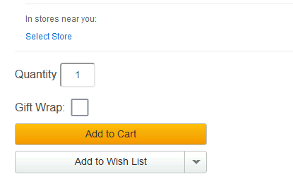
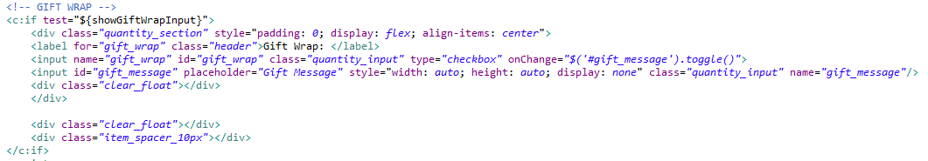
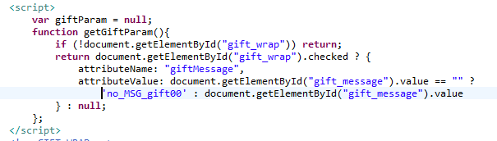
PART 1 STEP 4
Add gift wrap service on PDP page
Pass gift wrap input value on add to cart function

Slide 23
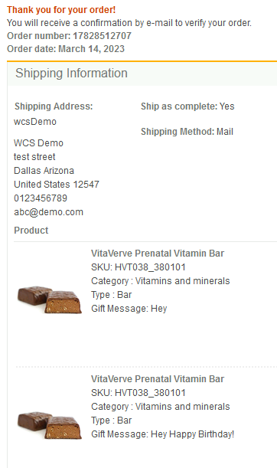
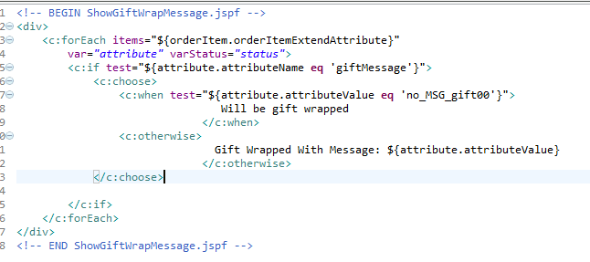
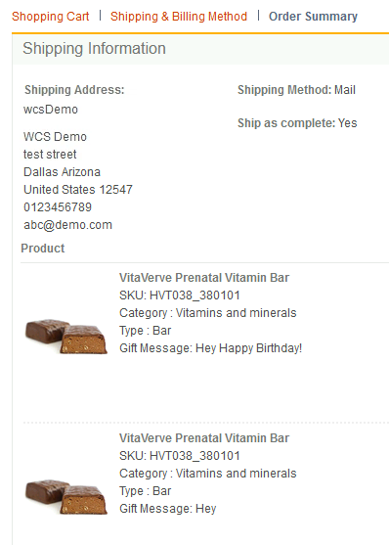
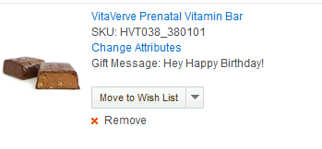
PART 1 STEP 4
Add to shopping cart page, checkout and order confirmation page

Slide 24
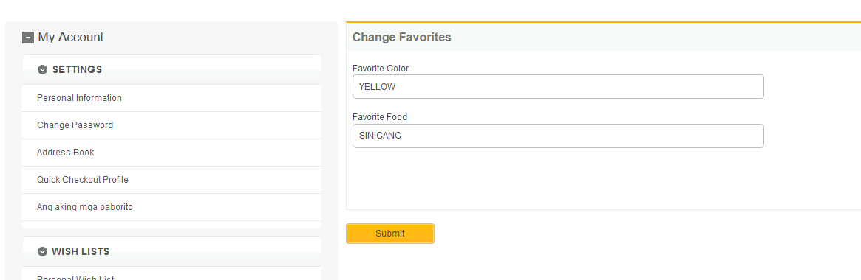
PART 2
Create a form where the user can manage their favorites
Add another link MyAccountNagivation_UI.jspf

Slide 25
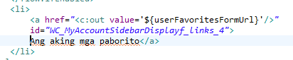
PART 2
Create a form where the user can manage their favorites
Add another link MyAccountNagivation_UI.jspf

Slide 26
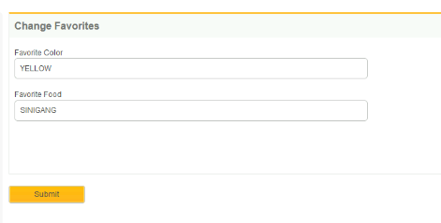
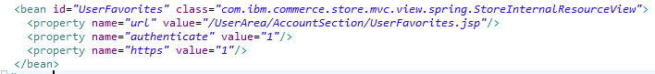
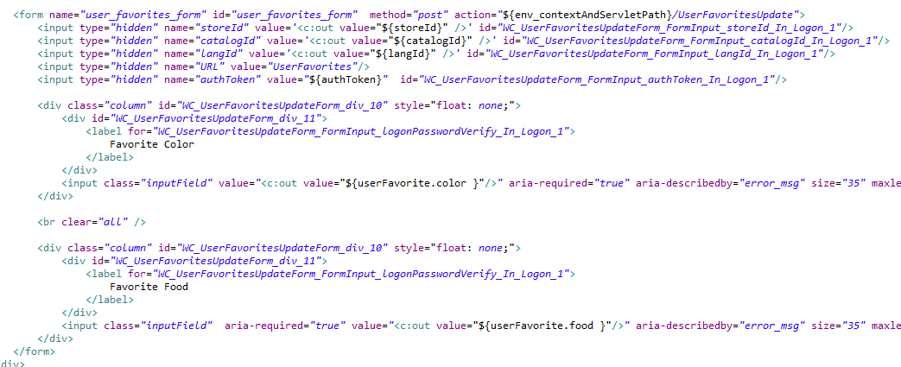
PART 2
Create a form where the user can manage their favorites
Register a new url in views-ext.xml
And assign this new jsp file to

Slide 27
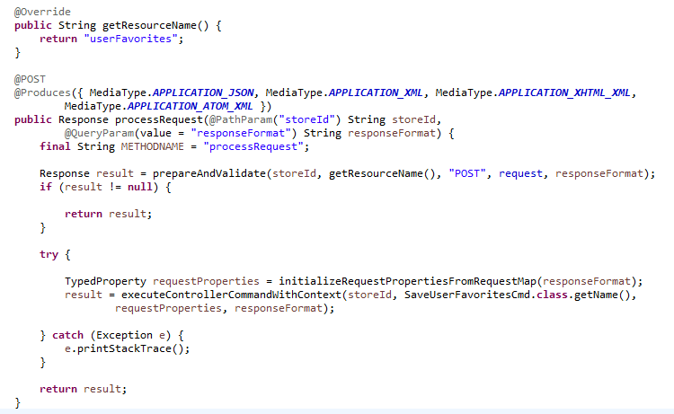
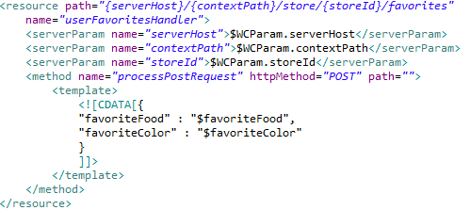
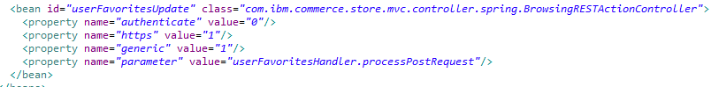
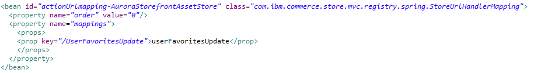
PART 2
Create Rest Handler that would process the requests
Register this new rest handler in resources-ext.xml.
Add a new resource on a new file rest-template-config.xml
Apply the declared resource on rest-template-config as parameter
Register the url and the bean

Slide 28
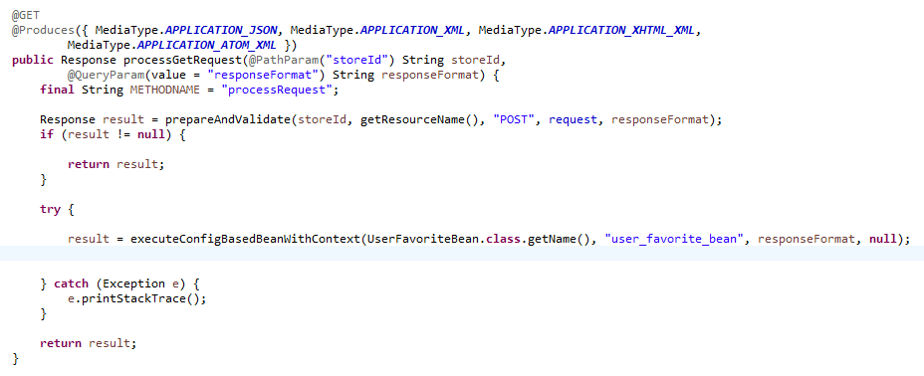
PART 2
Create Rest Handler that would process the requests
REST HANDLER GET REQUEST

Slide 29
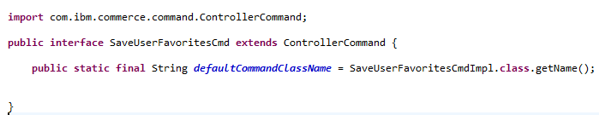
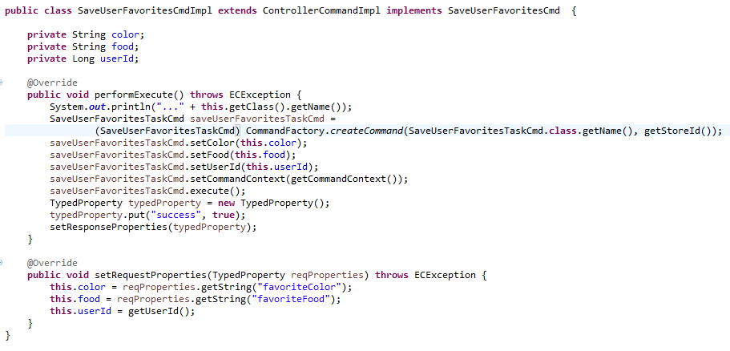
PART 2 Create Controllers and Task Command That would be executed on request
Controller Command interface For Saving Favorites
Implementation Controller Command For Saving Favorites

Slide 30
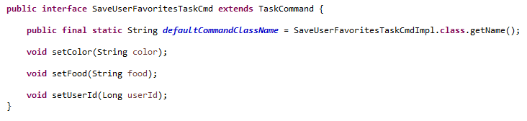
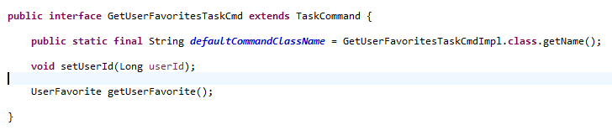
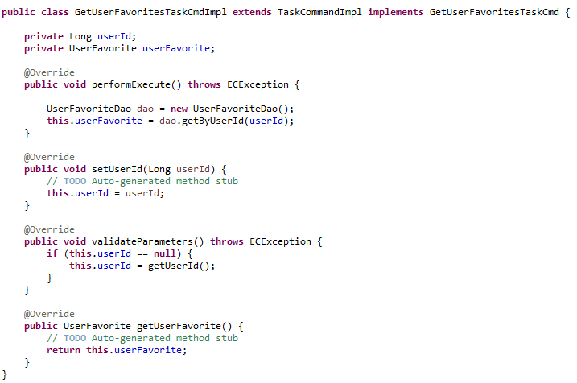
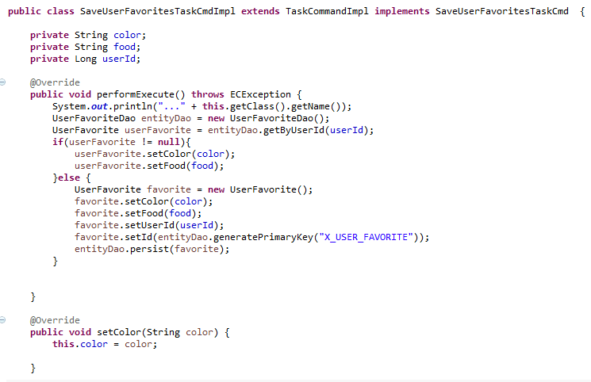
PART 2 Create Controllers and Task Command That would be executed on request
Task Command interface For Saving Favorites
Task Command interface For Retrieving Favorites
Task Command Implementation For Retrieving Favorites
Task Command Implementation For Saving Favorites

Slide 31
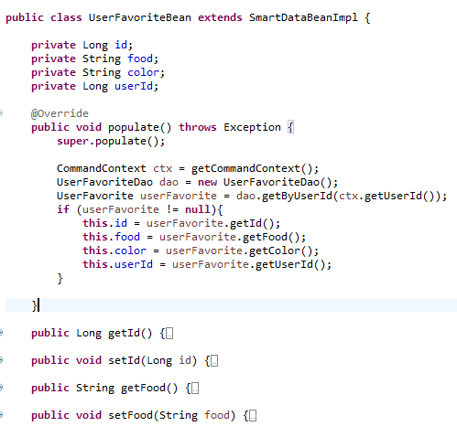
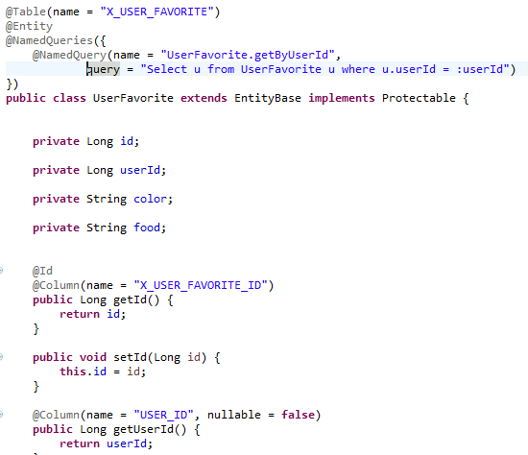
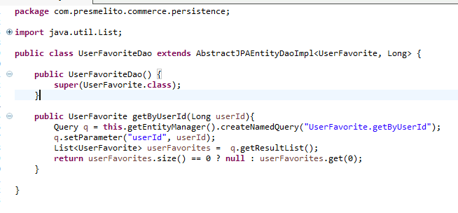
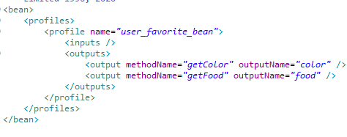
PART 2 Create Data Access Bean, DAO, Entity Class for Users Favorite
Data Access Bean
User Favorite Entity class
UserFavorite DAO
Create bean mapping

Slide 32
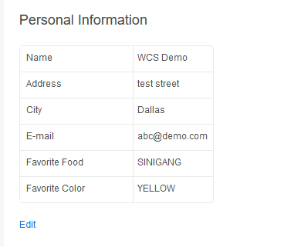
PART 2 Update UI to show Favorites in profile

Slide 33
Conclusion
The training and the capstone project gave me enough confidence that in the future if I will be Handling HCL commerce related projects I have enough knowledge to complete them.

Slide 34
Thank You
www.collaberadigital.com

